Slide 1
Catching Spam with Naive Bayes
COLLEGE PROJECT · MACHINE LEARNING
A spam classifier built from scratch and wired into a working, Gmail style inbox, trained only on real, publicly released email.
Ruchitra J · 25071A0533 · VNR VJIET
October 2026
Notes:
Open with the one line pitch: a Gmail style inbox with a real, working spam filter built from scratch, not borrowed from a library, trained only on real email.

Slide 2



Spam is not just annoying
THE PROBLEM
Spam is the easiest way to put phishing links, scams, and malware straight into someone's inbox. A filter that only matches a fixed list of words is simple to write, but just as simple to beat. Change one word, misspell it on purpose, add a stray character, and the message slips through untouched.
Why it matters
Phishing and scams ride along with ordinary looking mail
Keyword filters miss anything reworded or misspelled on purpose
What a real filter needs is judgment: a way to weigh a message's words together and decide how spam like it looks, even if it has never seen that exact wording before.
A statistical model can judge wording it has never seen before
Introduction
02 / 17
Notes:
Spam is not just clutter, it is a delivery channel for phishing and scams. Keyword filters are brittle and easy to dodge. We need a model that can judge new wording on its own.

Slide 3
What this project set out to do
OBJECTIVES
01
Build the model from scratch
No scikit-learn. Every probability is computed, and shown, by hand.
02
Train on real data only
The entire training set comes from one real, published email corpus.
03
Make it feel like a real inbox
A working Gmail style mailbox, not just a script in a terminal.
04
Explain every verdict
Show the priors, the log probabilities, and the exact words that mattered.
05
Report honest accuracy
Measure performance only on email the model never trained on.
Introduction
03 / 17
Notes:
Five concrete goals, not vague ones: build it ourselves, use only real data, make it feel like a product, explain every answer, and measure accuracy honestly.

Slide 4
Keyword filters versus a statistical model
BACKGROUND
Keyword filters
Naive Bayes, this project
Matches a fixed blocklist of words or phrases
Easy to write, just as easy to defeat with a misspelling or a stray space
Cannot judge wording it has never seen
Blocks or allows the whole message as one flat yes or no rule
Learns how statistically associated every word is with spam, from real examples
Combines all of a message's words into one spam probability
Can catch spam phrased in new ways, if the wording looks statistically similar
Every verdict comes with a number and a reason, never just a flag
Background
04 / 17
Notes:
Keyword filters are a flat rule. Naive Bayes is a judgment call built from statistics, which is why it generalizes to spam it has never literally seen before.

Slide 5
The data behind the model
BACKGROUND
33,716
17,171
16,545
Total real emails
Labeled spam
Labeled legitimate, ham
Of these, 33,672 emails are used to train the model. The remaining 35 are set aside before training even starts, by matching exact email text, not just a row number, since this corpus has many verbatim duplicate emails. Every email the live app shows you, in the inbox and in the Spam Detector presets, is one the model has genuinely never seen.
Source: Enron-Spam corpus. V. Metsis, I. Androutsopoulos, and G. Paliouras, "Spam Filtering with Naive Bayes, Which Naive Bayes?", CEAS 2006. Downloaded from a public GitHub mirror of the same released dataset.
Background
05 / 17
Notes:
Real email, labeled by real people, from an academic corpus built after the Enron investigation. No synthetic or hand written examples anywhere in training.

Slide 6
The idea: Bayes' theorem
THE METHOD · STEP 1 OF 3
P(message | spam) × P(spam)
P(spam | message) =
P(message)
P(spam | message)
P(message | spam)
Posterior
Likelihood
What we want to know: the chance this exact message is spam, after reading its words.
How probable this exact wording is, assuming the message really is spam.
P(spam)
P(message)
Prior
Evidence
How common spam is overall, before reading a single word. About 51% here, straight from the training data.
How probable this wording is overall. The same for every class being compared, so it can be dropped when just choosing spam versus ham.
Method
06 / 17
Notes:
Bayes theorem is just a rule for updating a belief once new evidence comes in. Here the belief is spam or not, and the evidence is the message's words.

Slide 7
From one word to a whole message
THE METHOD · STEP 2 OF 3
P(message | spam) ≈ P(w1|spam) × P(w2|spam) × ... × P(wn|spam)
Naive Bayes makes one simplifying, "naive" assumption: that every word's appearance is independent of the others, once you already know the class. That is rarely exactly true in real language, but it works remarkably well in practice, and it is what makes the math possible for a vocabulary of over a hundred thousand words.
log P(spam|message) ∝ log P(spam) + Σ log P(wi|spam)
Multiplying thousands of small probabilities together underflows to zero almost instantly on a real computer. Taking logarithms turns every multiplication into an addition, which is numerically stable and exactly as accurate. The same sum is computed for ham, and whichever total is larger wins.
Method
07 / 17
Notes:
The naive assumption is the one simplification that makes this tractable. Log space is purely an engineering fix for a real numerical problem, not a change in the math.

Slide 8
Handling zero counts, and turning odds into a percentage
THE METHOD · STEP 3 OF 3
P(word | class) = ( count(word, class) + α ) / ( total words in class + α × vocabulary size )
α = 1.0 in this project, known as Laplace smoothing
If a word never once appeared in the spam training set, its raw probability is exactly zero, and multiplying by zero would wipe out the whole product. Adding a small constant, alpha, to every count means no word is ever treated as impossible. Just unlikely.
P(spam | message) = 1 / ( 1 + e^-Δ ), where Δ = log P(spam|message) - log P(ham|message)
The sums from the previous step are log-odds: useful for comparison, but not a percentage anyone can read. The sigmoid function folds that difference back into a clean 0 to 100% probability, which is the number the app actually shows you.
Method
08 / 17
Notes:
Two practical fixes, not theoretical ones: smoothing stops a single unseen word from breaking the whole calculation, and the sigmoid turns raw log-odds into a readable percentage.

Slide 9

How the pieces fit together
SYSTEM
Enron-Spam corpus
prepare_dataset.py
classifier.py
app.py
Web UI
33,716 real emails, downloaded once
Splits data into training and held-out demo sets
Naive Bayes model, trained fresh at startup
Flask routes and the JSON API
index.html and app.js render the mailbox
evaluate.py retrains the same model on a fresh 80/20 split every time the server starts, and feeds those honest numbers straight into the About tab, so the accuracy you see is always measured, never hardcoded.
System
09 / 17
Notes:
Data flows one way: real corpus, split into train and demo, trained into the classifier, served by Flask, rendered by the UI. Evaluation runs in parallel, independently.

Slide 10
What it's built with
SYSTEM
Backend
Frontend
Python 3 and Flask, for routes and the JSON API
pandas, for loading and cleaning the CSV data
A Multinomial Naive Bayes classifier, written by hand, no scikit-learn
In-memory state for stars, sent mail, and feedback, for one running session
Plain HTML, CSS, and JavaScript, no framework
One single page app shell that fetches everything as JSON
Styled to look and feel like a real Gmail inbox
Search, starring, and the folder nav all genuinely work
Project layout
app.py Flask routes and the API
classifier.py Naive Bayes, written from scratch
dataset.py Loads training data, builds inbox and presets
evaluate.py Honest held-out accuracy, every startup
templates / static The Gmail style single page app
System
10 / 17
Notes:
Deliberately simple tooling. No framework, no ORM, no scikit-learn. The point was to understand every moving part, not to assemble prebuilt pieces.

Slide 11
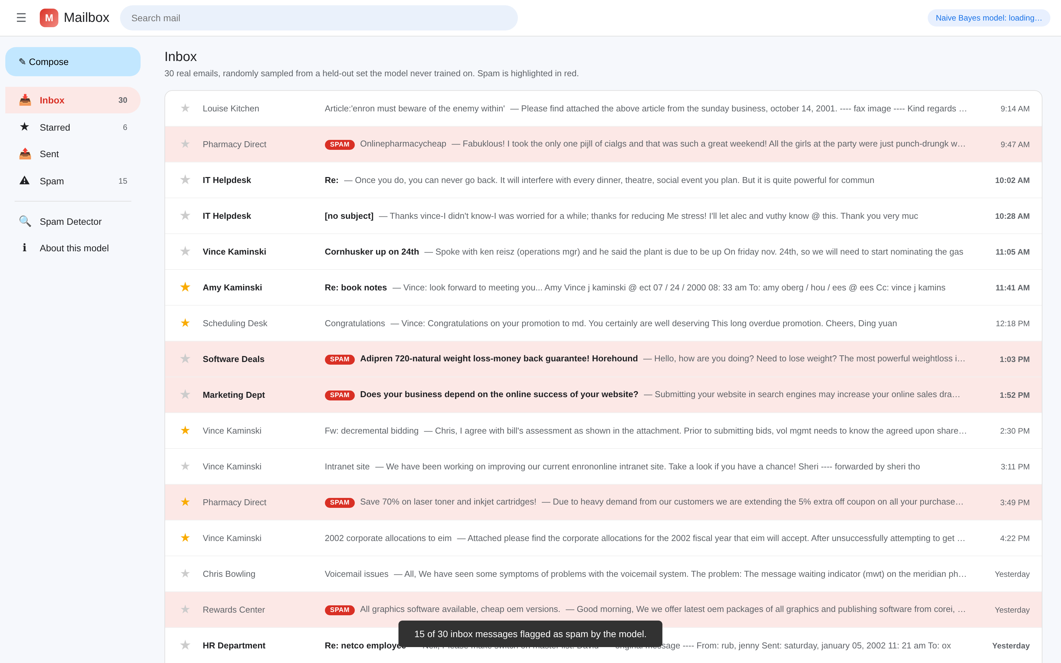
A real inbox, not a script
SYSTEM
Inbox, Starred, Sent, and Spam are real, separate folders
30 real emails, randomly sampled every server start, from a held-out pool the model never trained on
Spam is flagged in the list, and highlighted word by word inside the message
Search and starring both genuinely work
System
11 / 17
Notes:
This is the live app, running right now, not a mockup. Every row is a real Enron-Spam email the model has never trained on.

Slide 12
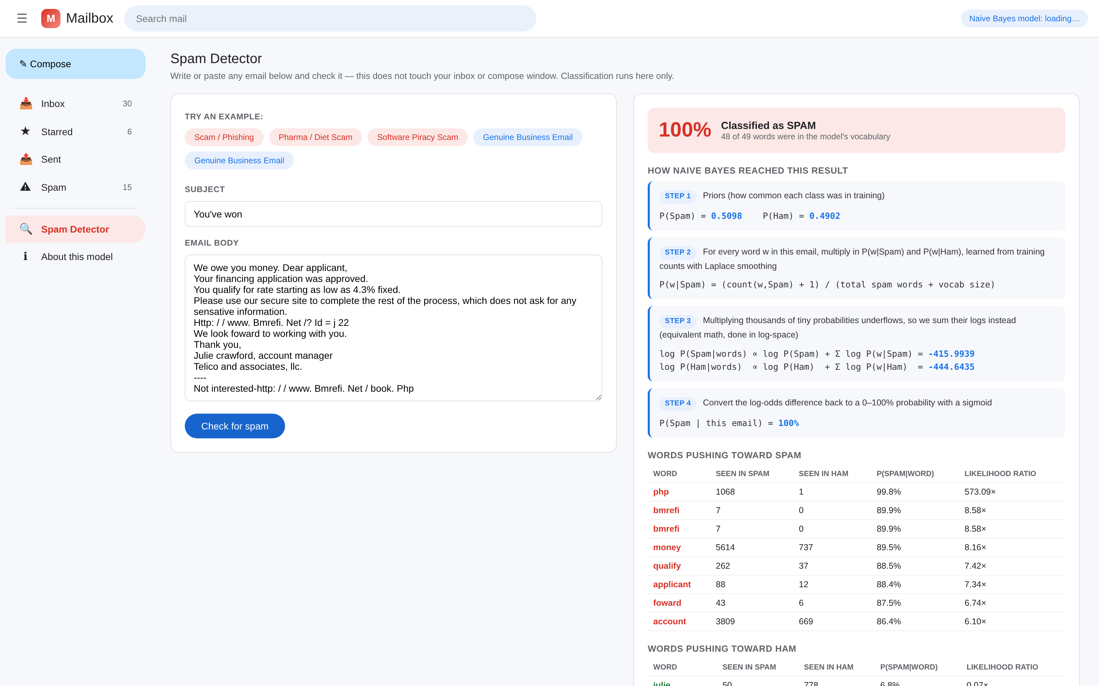
Explainable, not a black box
SYSTEM
The Spam Detector tab checks any text you write or paste, and shows the full Naive Bayes trail behind the verdict.
System
12 / 17
Notes:
Nothing is hidden. Every check shows the priors, the log probabilities, the sigmoid step, and the actual words that pushed the result toward spam or ham.

Slide 13
How well it actually performs
OUTCOMES
Trained on 26,970 real emails, tested on 6,702 it never saw, with duplicate emails grouped so none leak across the split. Measured fresh with every server start, never hardcoded.
98.64%
98.74%
98.59%
98.66%
Accuracy
Precision
Recall
F1 score
PREDICTED SPAM
PREDICTED HAM
3357
48
6,611 of 6,702 correct calls
Actual spam
True positive
False negative
91 of 6,702 mistakes
All 35 held-out demo emails, the ones the inbox and Spam Detector presets actually show, also classify correctly.
43
3254
Actual ham
False positive
True negative
Outcomes
13 / 17
Notes:
98.64% on real, unseen email, with duplicate emails grouped so none leak across the train/test split, is a strong and honest result for a hand written classifier. The mistakes are rare and roughly balanced between the two error types.

Slide 14




The real challenge was finding real data
OUTCOMES
Reaching the real dataset
Pre-tokenized, unreadable text
The usual sources were blocked from the build environment. A public mirror of the same released Enron-Spam corpus was reachable instead.
The source corpus is lowercased and split apart, so raw emails looked broken in the UI. A cosmetic cleanup fixes display only, never what the model sees.
A verdict reading only a preview
Keeping the demo set presentable
The inbox first judged spam from a short preview, not the full email. Classifying on the full subject and body fixed verdicts across the whole inbox.
A few real spam emails contained explicit language. Those are filtered only from the 35 demo emails, never from training, so the model still learns from all of it.
Outcomes
14 / 17
Notes:
Every one of these was a real bug or a real constraint found while building this, not a hypothetical. Each was diagnosed and fixed, not patched over.

Slide 15




What this project does not do, yet
OUTCOMES
No online learning. Disagreeing with a verdict in the Spam Detector does not retrain the model on the spot, it only logs the feedback for a future retrain.
In-memory state only. Stars, sent mail, and session feedback all reset the moment the server restarts. Nothing is written to a database.
Word frequency, not deep context. The model reasons about which words co-occur, not full sentence meaning, so unusual phrasing built from ordinary looking words can still slip past it.
One development server. Built and run for this class project, not hardened or scaled for production use.
Outcomes
15 / 17
Notes:
Stating limitations honestly, rather than overselling the prototype. Every one of these is a reasonable next step, not a hidden flaw.

Slide 16


Conclusion, and what's next
OUTCOMES
What this proved
Where it could go
A hand written Naive Bayes classifier can reach 98.64% accuracy on real, unseen email, with duplicates excluded so that number is honest
The math is not a black box: every verdict shows its priors, probabilities, and the words that mattered
Honestly held-out data, not a cleverer algorithm, was what made the biggest difference
Persist state in a real database, so stars, sent mail, and feedback survive a restart
Let feedback actually retrain the model, not just get logged
Add bigram or trigram features, not just single words, to catch more context
Package it as a browser extension for a real inbox, beyond this prototype
Outcomes
16 / 17
Notes:
End on the headline result and one or two future directions you are most excited about, then open the floor for questions.

Slide 17
References and sources
OUTCOMES
01
V. Metsis, I. Androutsopoulos, and G. Paliouras. "Spam Filtering with Naive Bayes, Which Naive Bayes?" CEAS 2006. Source of the Enron-Spam corpus.
02
Enron-Spam dataset mirror used for download: MWiechmann/enron_spam_data, GitHub.
03
Original Enron-Spam release, Athens University of Economics and Business, AUEB NLP group.
04
Flask documentation, flask.palletsprojects.com, for the web framework and routing.
05
pandas documentation, pandas.pydata.org, for loading and cleaning the CSV data.
Thank you.
Ruchitra J · VNR VJIET · 17 / 17
Notes:
Thank the audience and invite questions. Have the live app ready to open if anyone wants to see it running instead of in screenshots.

